Slide 1
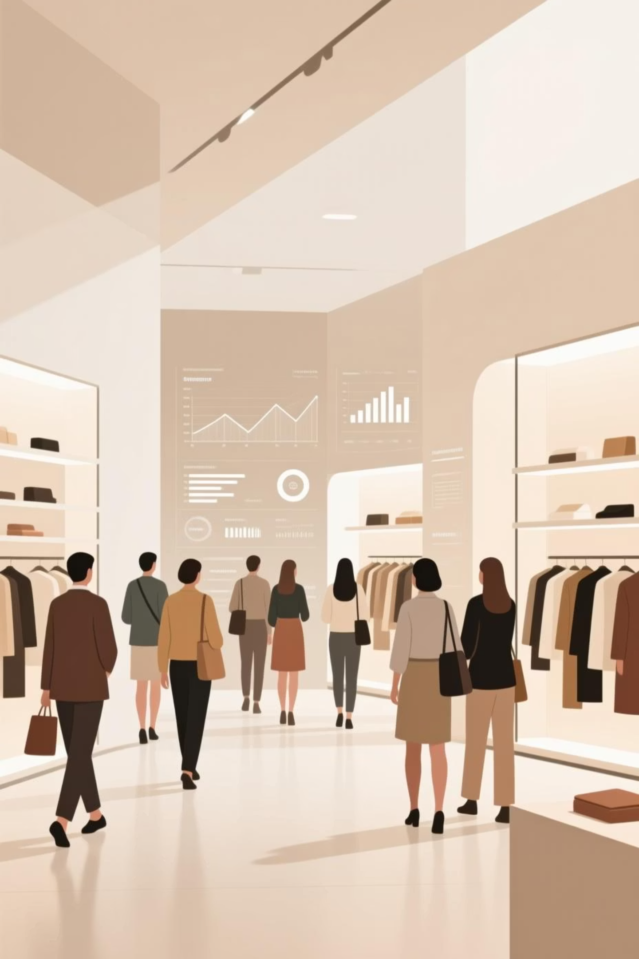
Customer Shopping Behavior Analysis
Uncovering insights from transactional data to guide strategic business decisions.

Slide 2

Project Overview
Goal
Data Source
Analyze 3,900 purchases to understand spending patterns, segments, and preferences.
Transactional data across various product categories.
Outcome
Actionable insights for business strategy.

Slide 3

Dataset Summary
Key Features
Data Volume
Customer demographics (Age, Gender, Location, Subscription Status)
3,900 Rows
Purchase details (Item, Category, Amount, Season, Size, Color)
18 Columns
Shopping behavior (Discount, Promo Code, Previous Purchases, Frequency, Review Rating, Shipping Type)
37 missing values in Review Rating

Slide 4
Exploratory Data Analysis (Python)
01
02
03
Data Loading & Exploration
Data Cleaning
Column Standardization
Imported dataset with pandas; checked structure and summary statistics.
Imputed missing 'Review Rating' values using median per category.
Renamed columns to snake_case for readability.
04
05
Feature Engineering
Database Integration
Created 'age_group' and 'purchase_frequency_days'.
Loaded cleaned data into PostgreSQL for SQL analysis.

Slide 5
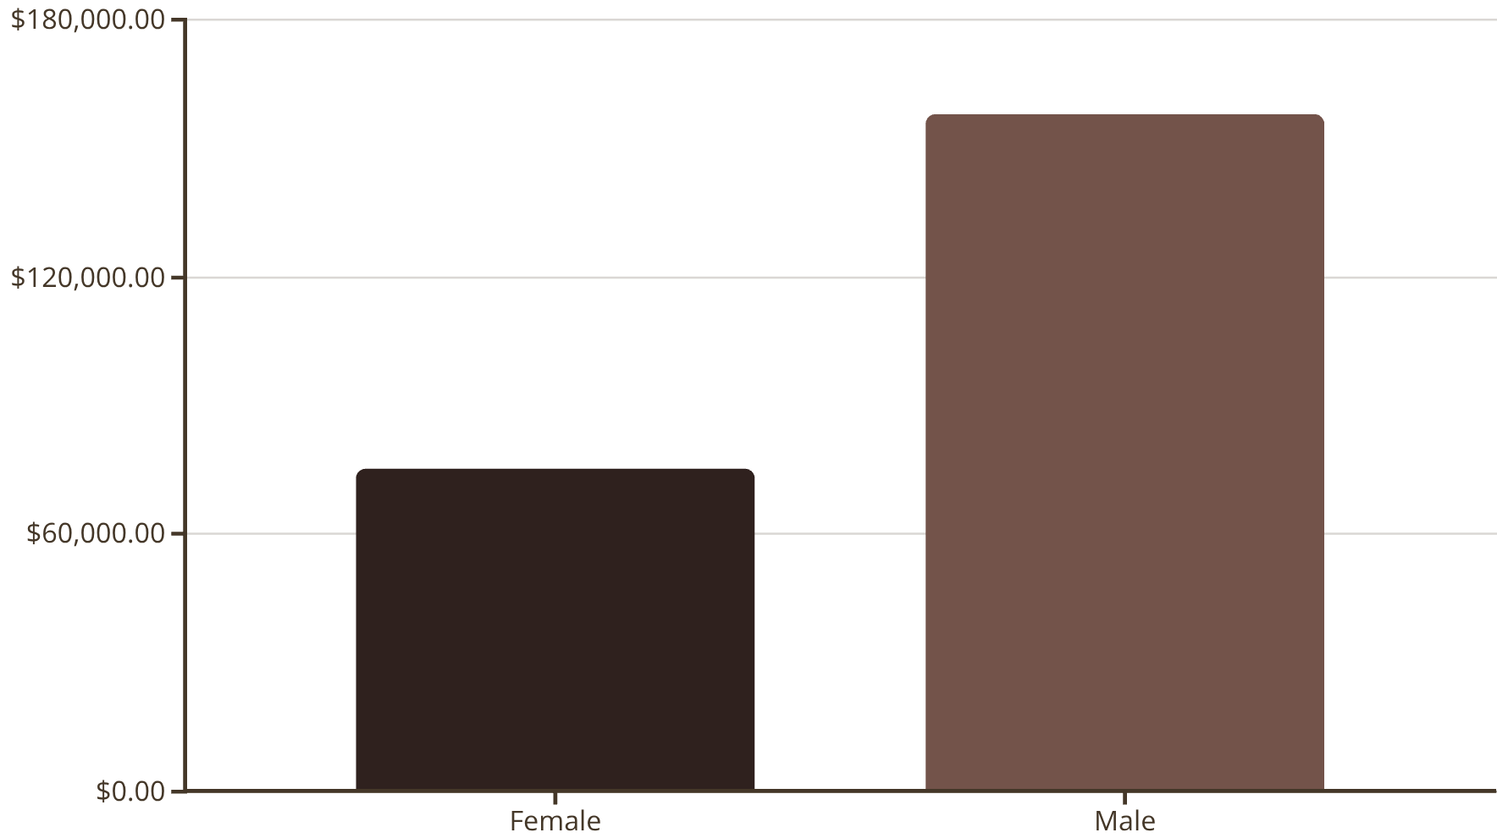

Data Analysis (SQL) - Revenue & Discounts
Revenue by Gender
High-Spending Discount Users
Identified 839 customers who used discounts but spent above average.
Discount-Dependent Products
Top 5 products with highest percentage of discounted purchases:
Hat (50%)
Sneakers (49.66%)
Coat (49.07%)

Slide 6

Product Performance & Shipping
1
Top 5 Products by Rating
Gloves (3.86), Sandals (3.84), Boots (3.82), Hat (3.80), Skirt (3.78).
2
Shipping Type Comparison
Express shipping users have slightly higher average purchase amounts ($60.48) than Standard ($58.46).

Slide 7
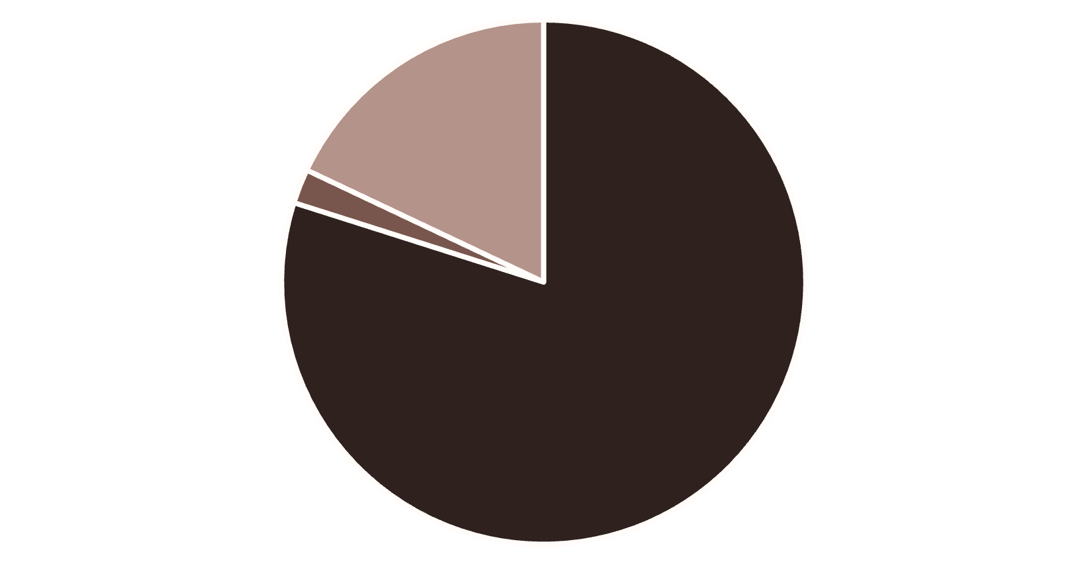
Subscription & Segmentation Insights
Subscribers vs. Non-Subscribers
Customer Segmentation
Yes
1053
$59.49
$62,645
No
2847
$59.87
$170,436
Non-subscribers contribute more total revenue due to higher volume.
Loyal
New
Returning
Majority of customers are loyal (3116).

Slide 8


Product Preferences by Category
Accessories
Jewelry, Sunglasses, Belt are top sellers.
Clothing
Blouse, Pants, Shirt are most purchased.
Footwear
Sandals, Shoes, Sneakers lead the category.
Outerwear
Jacket and Coat are top choices.

Slide 9
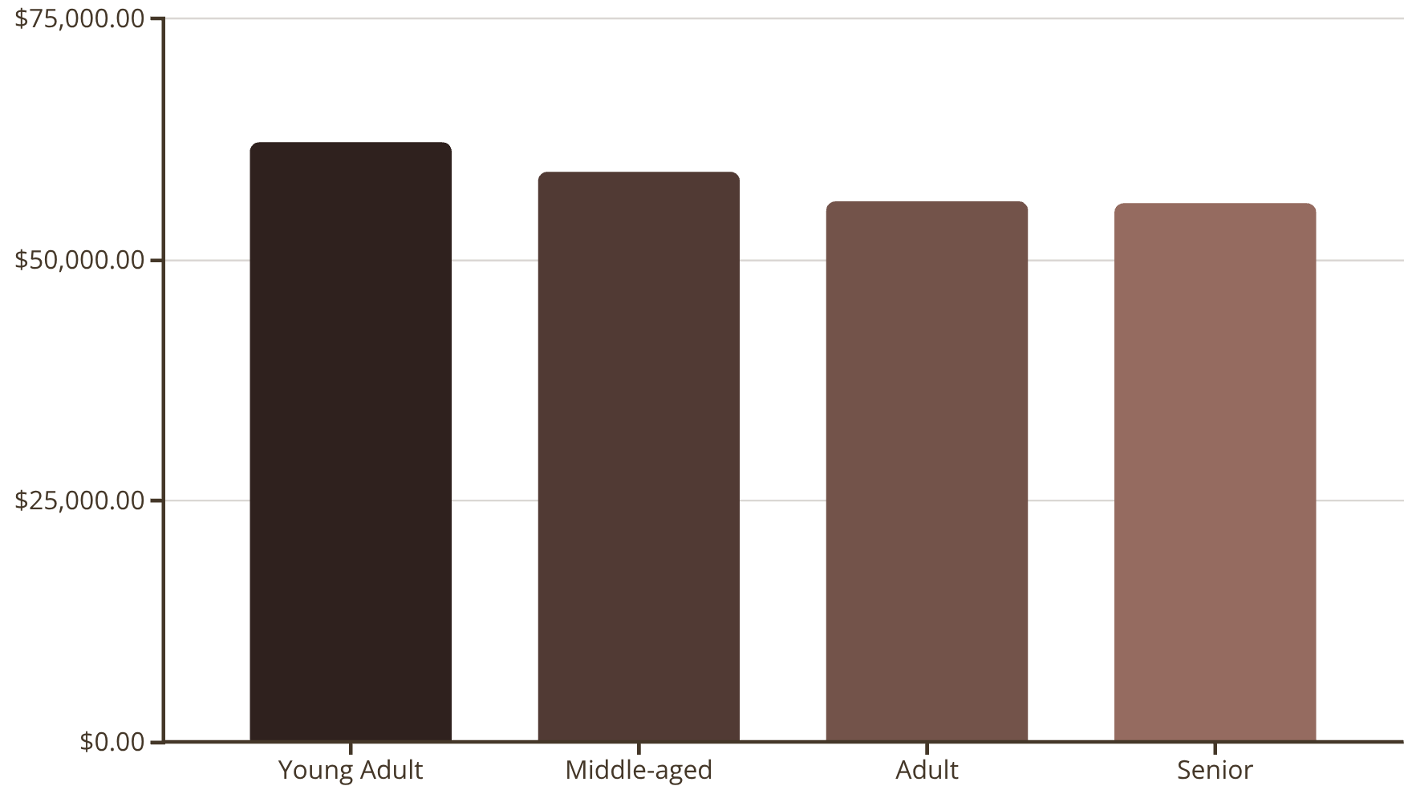

Age & Loyalty Trends
Repeat Buyers & Subscriptions
Revenue by Age Group
Customers with >5 purchases:
No Subscription: 2518
Yes Subscription: 958
Repeat buyers are less likely to subscribe.
Young Adults contribute the highest revenue.

Slide 10
Business Recommendations
Boost Subscriptions
Promote exclusive benefits to increase subscriber base.
Customer Loyalty Programs
Reward repeat buyers to foster loyalty and move them to "Loyal" segment.
Review Discount Policy
Strategically manage discounts to balance sales and profit margins.
Product Positioning
Highlight top-rated and best-selling products in marketing campaigns.
Targeted Marketing
Focus efforts on high-revenue age groups and express-shipping users.

